Slide 1

AI and Machine Learning for IoT Big Data

Slide 2
AI for prediction

Slide 3
Lecture 5: Prediction with AI
Learning from samples
Supervised learning algorithms
Multi-layer neural networks
Support Vector Machines
Deep Learning for prediction

Slide 4
Learning vs. memorization
Imagine showing the computer a picture of a cat, saying “A cat”. Computer says: “OK”
Show another cat; computer: “OK”
Show a dog, saying “A dog”; computer: “OK”
Show the first cat again, asking “What is this?”; computer says “A cat.”
Now show a third cat; computer says “No idea”. Is this what we want?
Notes:
Expand: if we are just matching pictures pixel to pixel, then the first cat photo, but with one pixel blacked out, would also get “No idea”.
We want the computer to recognize something common to cats, as opposed to common to dogs.
Some more hidden assumptions: we can expect to recognize only common traits that are evident from photos.
We expect learning “cats” vs. “dogs”, maybe “old cats” vs. “young cats” etc.
But for instance, can we expect to learn “Cats owned by women” vs. “Cats owned by men”?
Or, “German cats” vs. “Belgian cats”?
Can you start describing how you discriminate between cats and dogs?

Slide 5
What is “learning”?
In the context of prediction, learning is the creation of a function for estimating an unknown variable
The function should minimize the expectation of the error of estimation
The function should use available observations and possibly a-priori knowledge about the domain

Slide 6
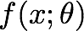

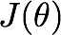

Learning as optimization
We want to find the true mapping that transforms the inputs x into the outputs y for the distribution p of the data
Define the mapping as a family of functions parametrized by
Define the error as the expectation of the distance L between the mapping and the true y:
Then we want the that minimizes
Notes:
J(\theta) = \mathbb{E}_{(x,y)\sim\hat{p}_{data}} L(f(x;\theta),y)

Slide 7
Learning vs. optimization
The true distribution p of the data is unknown, we can only infer it from sample pairs of (x,y)
Thus the best we can do is finding a mapping that fits the samples, hoping that it will fit also other, unknown samples
Choosing a “good one” between the infinite number of possible mappings is the art of machine learning
Notes:
Important: a properly defined data distribution p would still require effort to generate an explicit mapping function, but in principle we would not need to introduce tricks with regularization, validation etc. These things come from the need to infer the hidden distribution, and are techniques for adding an implicit model of how we expect p to behave.

Slide 8
What functions to use?
Traditional regression: use a linear estimate mapping observed inputs to observed outputs
“Learning” for regression: least mean squares
Neural networks: use nonlinear functions with biologically inspired structures
“Learning” for neural networks: many heuristic procedures

Slide 9
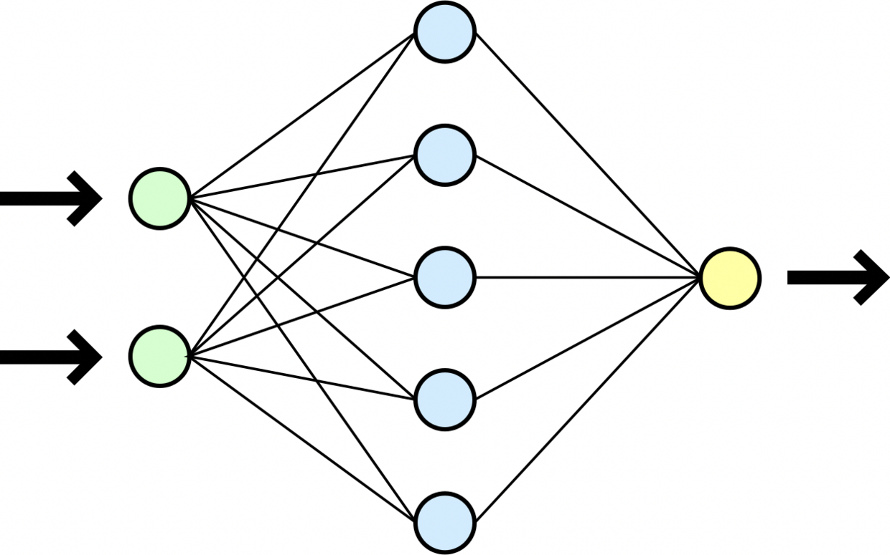

Multi-Layer Perceptron
By Dirk Hünniger (Own work) [CC BY 3.0 (http://creativecommons.org/licenses/by/3.0)], via Wikimedia Commons
Example with 2 inputs, 1 output, 1 hidden layer
The lines indicate “connections” or “synapses”

Slide 10
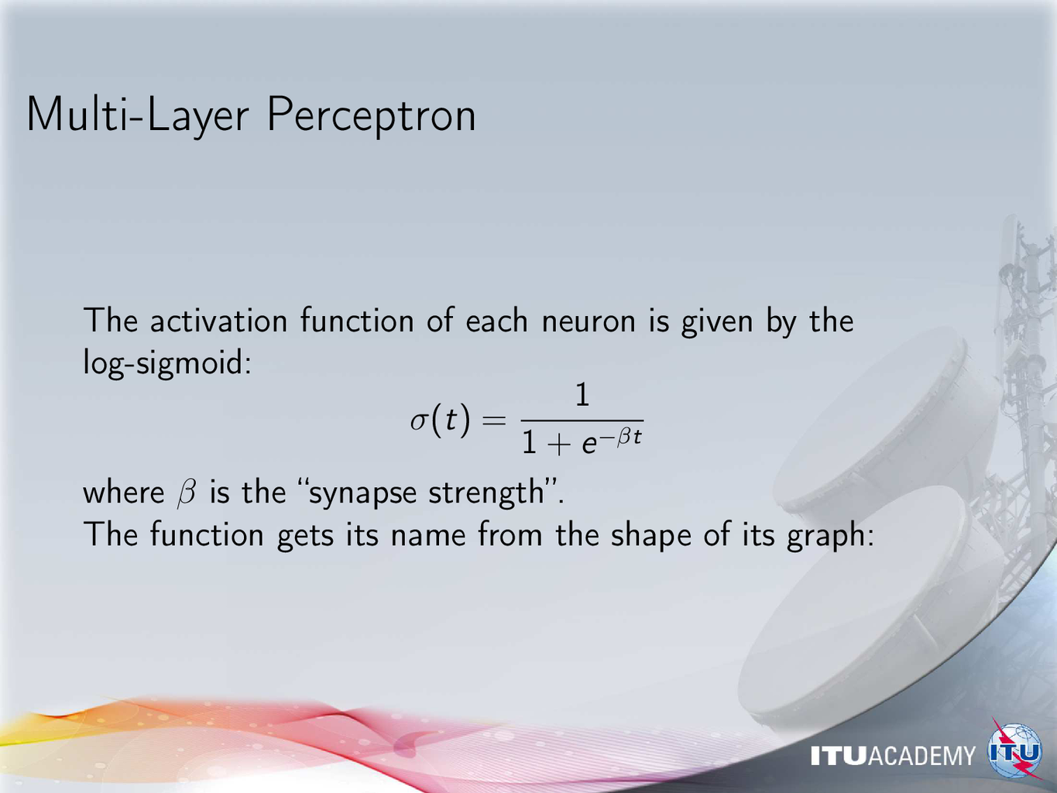

Slide 11
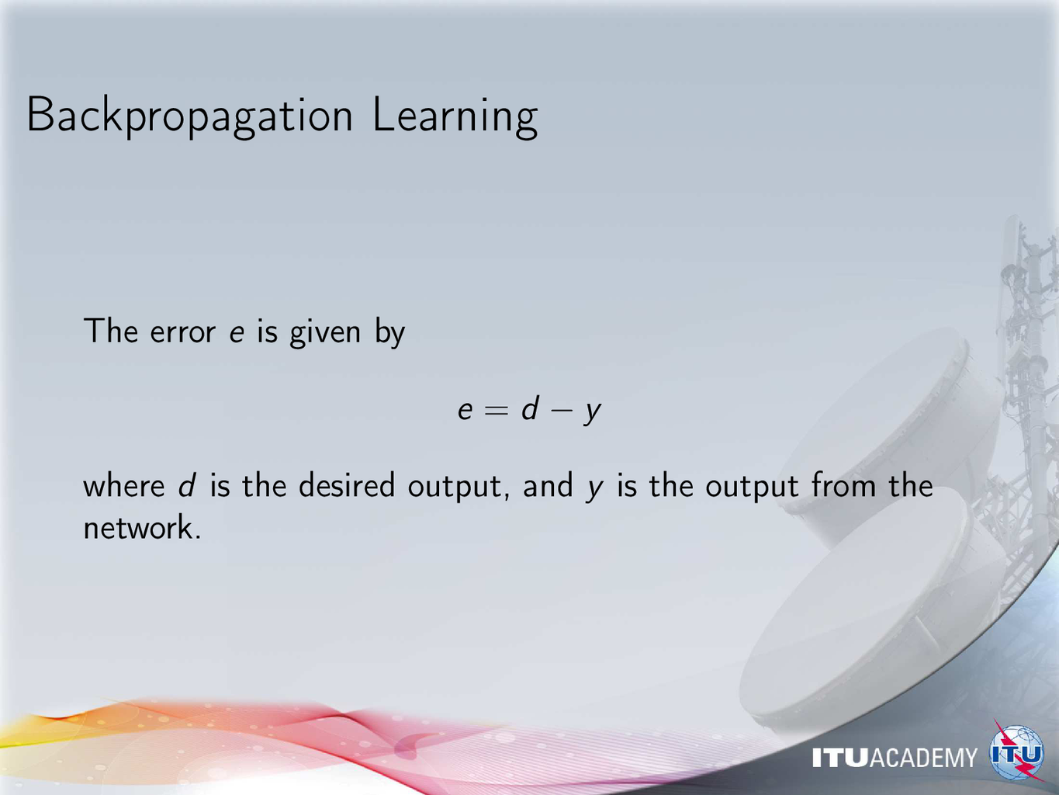

Slide 12
Support Vector Machine
https://commons.wikimedia.org/wiki/File:Svm_10_perceptron.JPG
Finding the separating hyperplane between classes
even when there is no linear separation

